Slide 1
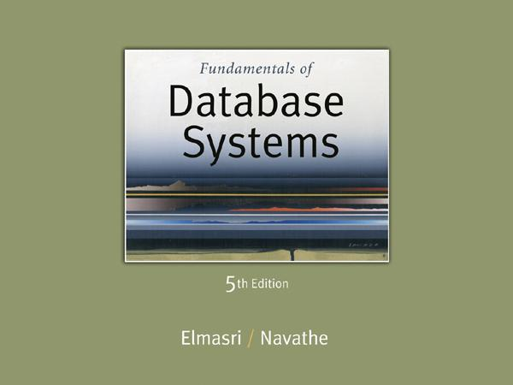
Slide 10- 1
Notes:
1

Slide 2
3.3 Second Normal Form (1)
Uses the concepts of FDs, primary key
Definitions
Prime attribute: An attribute that is member of the primary key K
Full functional dependency: a FD Y -> Z where removal of any attribute from Y means the FD does not hold any more
Examples:
{SSN, PNUMBER} -> HOURS is a full FD since neither SSN -> HOURS nor PNUMBER -> HOURS hold
{SSN, PNUMBER} -> ENAME is not a full FD (it is called a partial dependency ) since SSN -> ENAME also holds
Slide 10- 2
Notes:
2

Slide 3
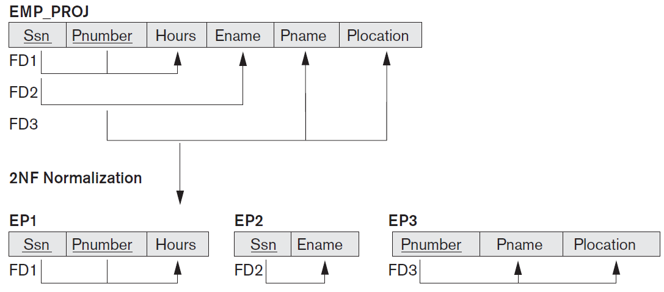

Slide 4
Second Normal Form (2)
A relation schema R is in second normal form (2NF) if every non-prime attribute A in R is fully functionally dependent on the primary key
R can be decomposed into 2NF relations via the process of 2NF normalization
Slide 10- 4
Notes:
4

Slide 5
Second Normal Form (Example)
Example
Given relation R(ABC)
FDs: {AB->C and B->C}
Here, AB is candidate key and B->C gives partial dependency
R(ABC) can be decomposed into R1(AB) and R2(BC)
Lossless decomposition???
FD Preserving ????

Slide 6
Second Normal Form (Problem)
Q. R(ABCD)
FDs:{AB->C, B->D}
Decompose given relation in 2NF

Slide 7
3.4 Third Normal Form (1)
Definition:
Transitive functional dependency: a FD X -> Z that can be derived from two FDs X -> Y and Y -> Z
Examples:
SSN -> DMGRSSN is a transitive FD
Since SSN -> DNUMBER and DNUMBER -> DMGRSSN hold
SSN -> ENAME is non-transitive
Since there is no set of attributes X where SSN -> X and X -> ENAME
Slide 10- 7
Notes:
7

Slide 8
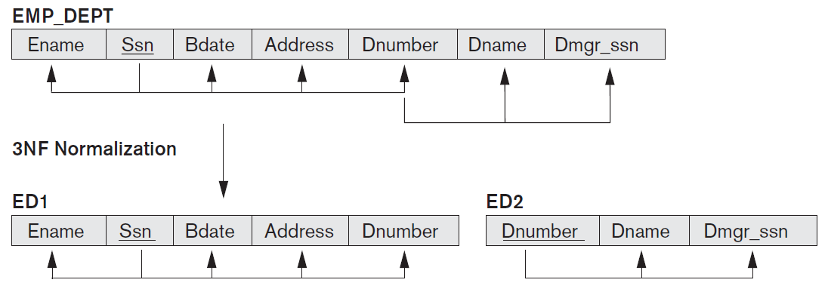

Slide 9
Third Normal Form (2)
A relation schema R is in third normal form (3NF) if it is in 2NF and no non-prime attribute A in R is transitively dependent on the primary key
R can be decomposed into 3NF relations via the process of 3NF normalization
NOTE:
In X -> Y and Y -> Z, with X as the primary key, we consider this a problem only if Y is not a candidate key.
When Y is a candidate key, there is no problem with the transitive dependency .
E.g., Consider EMP (SSN, Emp#, Salary ).
Here, SSN -> Emp# -> Salary and Emp# is a candidate key.
Slide 10- 9
Notes:
9

Slide 10
General Definition of Third Normal Form
Definition. A relation schema R is in third normal form (3NF) if, whenever a nontrivial functional dependency X->A holds in R, either
(a) X is a superkey of R, or
(b) A is a prime attribute of R.

Slide 11
Third Normal Form (Example)
Ex: R(ABC)
FD:{A->B, B->C}
Candidate key=A
A is prime attribute which is transitively determining the non prime attribute C.
B->C gives transitive dependency hence not allowed in 3NF.
So decomposed relations will be R1(AB) and R2(BC)
Lossless decomposition???
FD Preserving ????

Slide 12
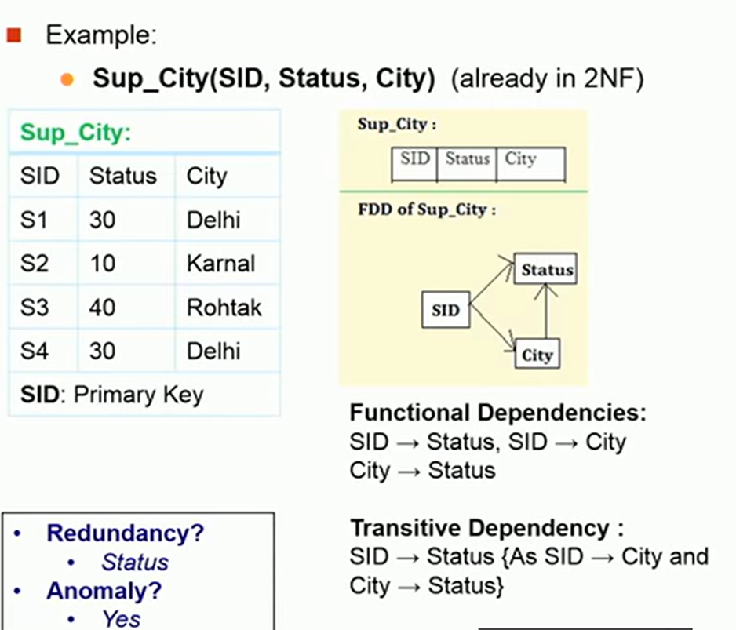

Slide 13
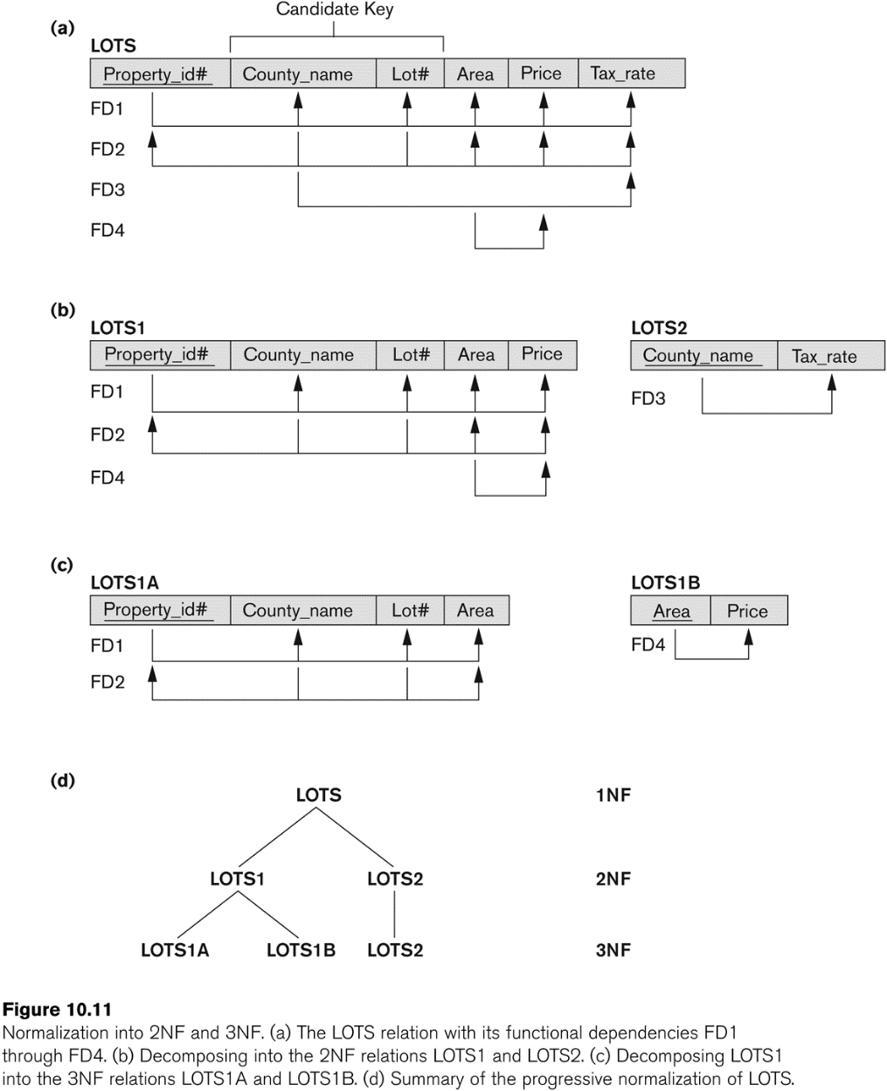
Figure 10.11 Normalization into 2NF and 3NF
Slide 10- 13
Notes:
13

Slide 14
Third Normal Form (Problem)
Q. R(ABCDE)
FD:{AB->C, B->D, D->E}
Solve the following steps:
Step1: Find Candidate key
Step2: Check the relations in 3NF, if not decompose
Finally check decomposition is lossless and FD preserving

Slide 15
4 General Normal Form Definitions (For Multiple Keys) (1)
The above definitions consider the primary key only
The following more general definitions take into account relations with multiple candidate keys
A relation schema R is in second normal form (2NF) if every non-prime attribute A in R is fully functionally dependent on every key of R
Slide 10- 15
Notes:
15

Slide 16
General Normal Form Definitions (2)
Definition:
Superkey of relation schema R - a set of attributes S of R that contains a key of R
A relation schema R is in third normal form (3NF) if whenever a FD X -> A holds in R, then either:
(a) X is a superkey of R, or
(b) A is a prime attribute of R
NOTE: Boyce-Codd normal form disallows condition (b) above
Slide 10- 16
Notes:
16

Slide 17
5 BCNF (Boyce-Codd Normal Form)
A relation schema R is in Boyce-Codd Normal Form (BCNF) if whenever an FD X -> A holds in R, then X is a superkey of R
Each normal form is strictly stronger than the previous one
Every 2NF relation is in 1NF
Every 3NF relation is in 2NF
Every BCNF relation is in 3NF
There exist relations that are in 3NF but not in BCNF
The goal is to have each relation in BCNF (or 3NF)
Slide 10- 17
Notes:
17

Slide 18
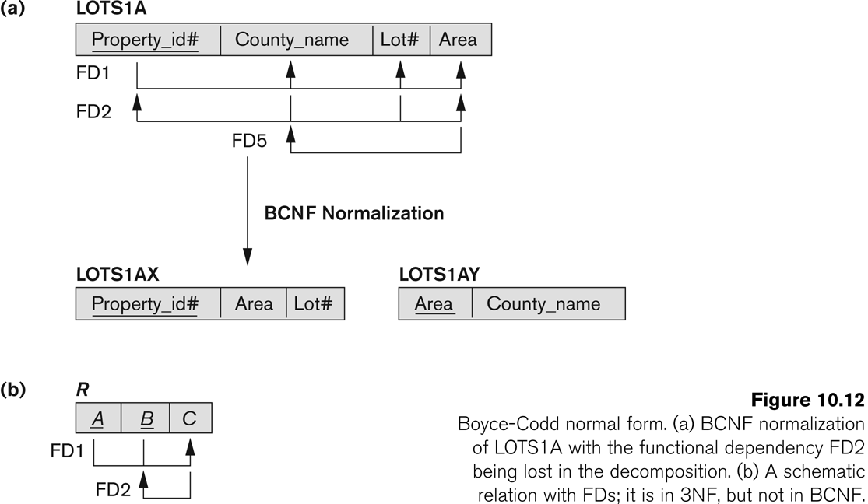
Figure 10.12 Boyce-Codd normal form
Slide 10- 18
Notes:
18

Slide 19
BCNF Example
Ex: R(ABC)
FD:{AB->C, C->B}
AB and AC both are candidate keys, hence ABC are prime attributes.
Acc to 3NF definition the given relation is in 3NF.
Check in BCNF?
LHS of FDs should be a super key. Here, C is not superkey.
So Decompose relation into R1(AC) and R2(CB)
Lossless decomposition???
FD Preserving ????

Slide 20
Practice Problem
Q. R(ABCDEFGHI)
FD:{AB->C, A->DE, B->F, F->GH, D->IJ}
Solve the following steps:
Step1: Find Candidate key
Step2: Check R in 2NF, if not decompose
Step3: Check the relations in 3NF, if not decompose
Step4: Check the relations in BCNF, if not decompose
Finally check decomposition is lossless and FD preserving

Slide 21
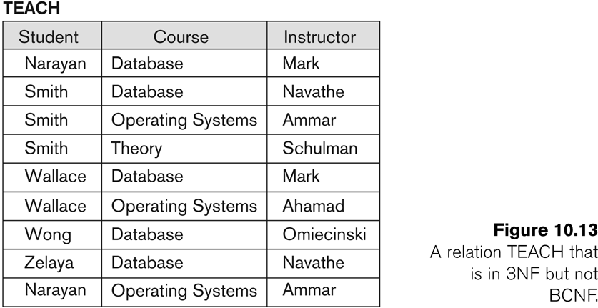
Figure 10.13 a relation TEACH that is in 3NF but not in BCNF
Slide 10- 21
Notes:
21

Slide 22
Achieving the BCNF by Decomposition (1)
Two FDs exist in the relation TEACH:
fd1: { student, course} -> instructor
fd2: instructor -> course
{student, course} is a candidate key for this relation and that the dependencies shown follow the pattern in Figure 10.12 (b).
So this relation is in 3NF but not in BCNF
A relation NOT in BCNF should be decomposed so as to meet this property, while possibly forgoing the preservation of all functional dependencies in the decomposed relations.
Slide 10- 22
Notes:
22

Slide 23
Achieving the BCNF by Decomposition (2)
Three possible decompositions for relation TEACH
{student, instructor} and {student, course}
{course, instructor } and {course, student}
{instructor, course } and {instructor, student}
All three decompositions will lose fd1.
We have to settle for sacrificing the functional dependency preservation. But we cannot sacrifice the non-additivity property after decomposition.
Out of the above three, only the 3rd decomposition will not generate spurious tuples after join.(and hence has the non-additivity property).
Slide 10- 23
Notes:
23

Slide 24
Chapter Outline
Informal Design Guidelines for Relational Databases
Functional Dependencies (FDs)
Definition, Inference Rules, Equivalence of Sets of FDs, Minimal Sets of FDs
Normal Forms Based on Primary Keys
General Normal Form Definitions (For Multiple Keys)
BCNF (Boyce-Codd Normal Form)
Slide 10- 24
Notes:
24

